Slide 1

DECODING THE EVOLUTION OF HEALTHCARE TECHNOLOGIES
Mapping Medical Innovation

Slide 2

Why this matters ?
Improves diagnosis and treatment precision
Fosters new treatments and care models
Streamlines operations and reduces errors
Brings care to Underserved areas
Reduces administrative burdens

Slide 3
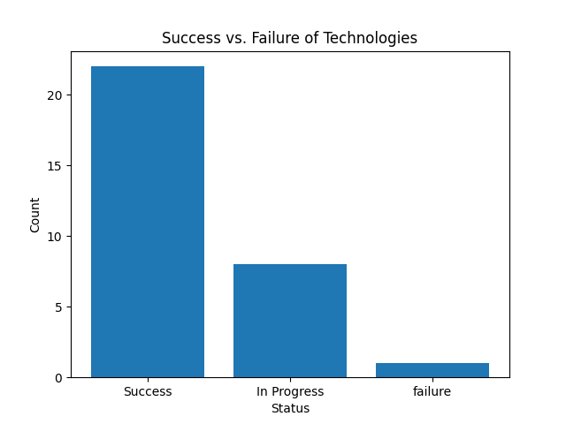
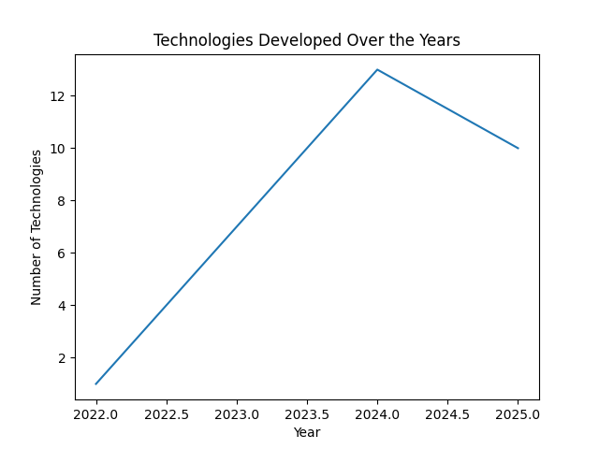
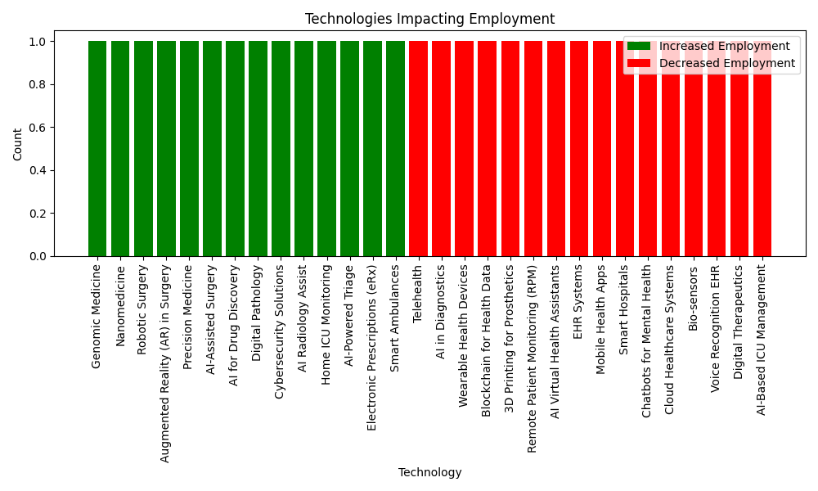

A visual exploration
Technology Growth Insights

Slide 4
Benefits & Challenges of Health Tech
Future of Healthcare
​Enhanced Diagnostic Accuracy​
​Improved Accessibility​
​Personalized Treatment​
​Operational Efficiency​
​Cost Reduction in Long-Term Care
ADVANTAGES
​High Implementation Costs​
​Data Privacy and Security Risks​
​Depersonalization of Patient Care​
​Over-Reliance on Technology​
​Technical Challenges and System Failures
DISADVANTAGES

Slide 5

Thank you
Innovating Today for a Healthier Tomorrow

